Slide 1

CO1-AT3-TECHNICAL PRESENTATION
CSA0509 : Database Management Systems
GUIDED BY
Dr. C. Kesavan
PRESENTED BY :
Jaya shree .S (192524146)

Slide 2


Introduction :-
Q1) ER Diagram for Online Library System
An Online Library System is a database application used to manage books, members, authors, and book borrowing activities. It helps users search, borrow, and return books efficiently.
Objectives
Store book information
Manage members
Reduce manual work

Slide 3
Components of ER Diagram
1) Entity
Represents a real-world object.
Shown using a Rectangle.
Examples:
Book
Member
Author
Librarian
2)Attribute
Describes the properties of an entity.
Shown using an Oval.
Examples:
Book ID
Title
Member Name
Email

Slide 4
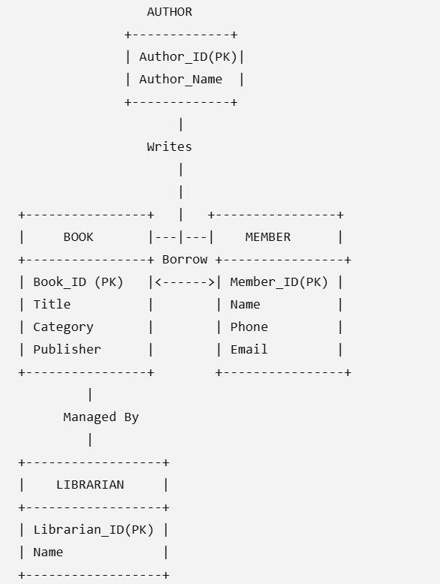
ER Diagram

Slide 5
Advantages
Easy database design
Shows relationships clearly
Reduces data redundancy
Improves data management
Easy maintenance.

Slide 6
Conclusion
ER diagrams provide a clear structure of the database.
They identify entities, attributes, and relationships.
An Online Library ER diagram helps manage books, members, authors, and borrowing efficiently.

Slide 7
Introduction
Q2) Prepare a presentation on the EER model, demonstrating generalization and specialization with a University case study.
The Extended Entity-Relationship (EER) Model is an advanced version of the ER model.
It is used to design complex databases.
The EER model includes Generalization, Specialization
In a University system, Person is divided into Student, Faculty, and Staff

Slide 8
Components
Generalization
Combines similar entities into one Superclass (Person).
Specialization
Divides Person into Student, Faculty, and Staff based on their roles.
Superclass
Person :-Common entity that stores shared
information.
Subclasses
Student – Stores student details.
Faculty – Stores faculty details.
Staff – Stores staff details.

Slide 9
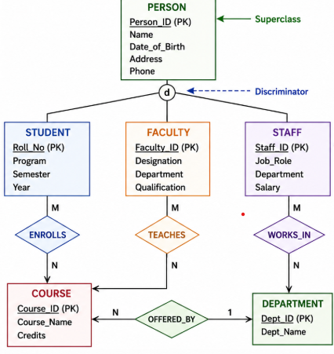
ER Diagram

Slide 10
Advantages
Maintains patient records.
Reduces paperwork.
Improves appointment scheduling.
Enhances data security.
Enables quick access to medical information.

Slide 11
Conclusion
The EER Model is an advanced version of the ER model.
It uses Generalization and Specialization to organize data efficiently.
It reduces data redundancy and improves database structure.
In the University case study, Person is divided into Student, Faculty, and Staff.
Overall, the EER model helps create a simple, efficient, and well-organized database.

Slide 12
Introduction
Q3. Present the concept of data independence (logical and physical) and its significance in DBMS architecture.
Data independence is the ability to change the database structure without affecting application programs.
It is an important feature of a Database Management System (DBMS).
There are two types of data independence: Logical and Physical.
It improves database flexibility, maintenance, and performance.

Slide 13
Type of data independence
Logical Data Independence
Ability to change the logical structure without affecting user applications.
Example:
Adding a new column (Email) to the Student table.
Physical Data Independence
Ability to change the physical storage without affecting the logical structure.
Example:
Creating an index to improve search speed.
Changing file organization or storage device.

Slide 14
Advantages
Reduces maintenance cost.
Improves database security.
Increases flexibility.
Allows easy database updates.
Enhances system performance.

Slide 15
Conclusion
Data independence is an important feature of DBMS.
It separates applications from the database structure.
Logical data independence protects applications from logical changes.
Overall, it makes the database more flexible, efficient, and easy to maintain.

Slide 16
Introduction
Q4) software components of a DBMS, explaining query processor, storage manager, and transaction manager
A Database Management System (DBMS) is software used to store, manage, and retrieve data.
It helps users access data quickly and securely.
A DBMS consists of different software components that work together.
The main components are Query Processor, Storage Manager, and Transaction Manager.

Slide 17
Components
Query Processor
Accepts SQL queries from users.
Checks the query for errors.
Optimizes the query.
Transaction Manager
Controls database transactions.
Maintains data consistency
Prevents data loss and inconsistency.
Handles commit and rollback operations.
Storage Manager
Manages the storage of data in the database.
Retrieves data whenever requested.
Maintains files, indexes, and memory.
Ensures data is stored securely and efficiently.

Slide 18
Diagram
User sends an SQL query.
Query Processor checks and executes the query.
Transaction Manager manages the transaction safely.
Storage Manager accesses the required data.
The result is returned to the user.

Slide 19
Advantages
Manages student records efficiently.
Organizes course information.
Simplifies faculty management.
Improves academic record keeping.
Reduces paperwork.

Slide 20
Conclusion
The Query Processor processes SQL queries.
The Storage Manager manages data storage and retrieval.
The Transaction Manager ensures safe and reliable transactions.
All three components work together for efficient database management.
They make the DBMS fast, secure, and reliable.

Slide 21
Introduction
Q5) Strong and Weak Entities in ER Modeling
In an Entity-Relationship (ER) model, entities represent real-world objects stored in a database. Based on their dependency, entities are classified into:
Strong Entity
Weak Entity
Understanding these entities helps in designing an efficient and accurate database.

Slide 22
Components
1. Strong Entity
Has its own Primary Key.
Exists independently.
Example: Customer
2. Weak Entity
Depends on a Strong Entity.
Cannot exist without the Strong Entity.
Example: Order
3. Attributes
Customer
Customer_ID (PK)
Name
Phone
Order
Order_No (Partial/Dependent Key)
Order_Date
Amount
4. Relationship
Customer Places Order.

Slide 23
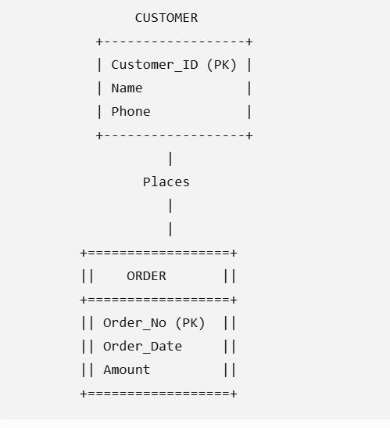
ER Diagram

Slide 24
Comparison Table
Strong Entity | Weak Entity
Has Primary Key | Depends on Strong Entity
Exists Independently | Cannot Exist Alone
Single Rectangle | Double Rectangle
Independent | Dependent

Slide 25
Advantages
Strong Entity
Easy to identify.
Stores independent data.
Simplifies database design.
Weak Entity
Reduces data redundancy.
Maintains data integrity.
Represents dependent information accurately.

Slide 26
Conclusion
A Strong Entity has its own primary key and exists independently.
A Weak Entity depends on a strong entity for identification.
Using both entities improves database structure, integrity, and relationship management.

